Slide 1
Payments (Project 1) Cohort Analysis
Understand user behaviors and performance across key metrics

Slide 2
Challenges
Inputs:
cash_req_df
fees_df
Performed initial data exploration (.info()), .head, .columns)
Cleaned and preprocessed the data
Managed the dataset with pandas
functions: merge, isnull(), duplicated(), groupby, to_datetime
Defined user cohorts based on user_id and activity date
Visualized key metrics through plots
Interpreted findings based on the visual analysis

Slide 3
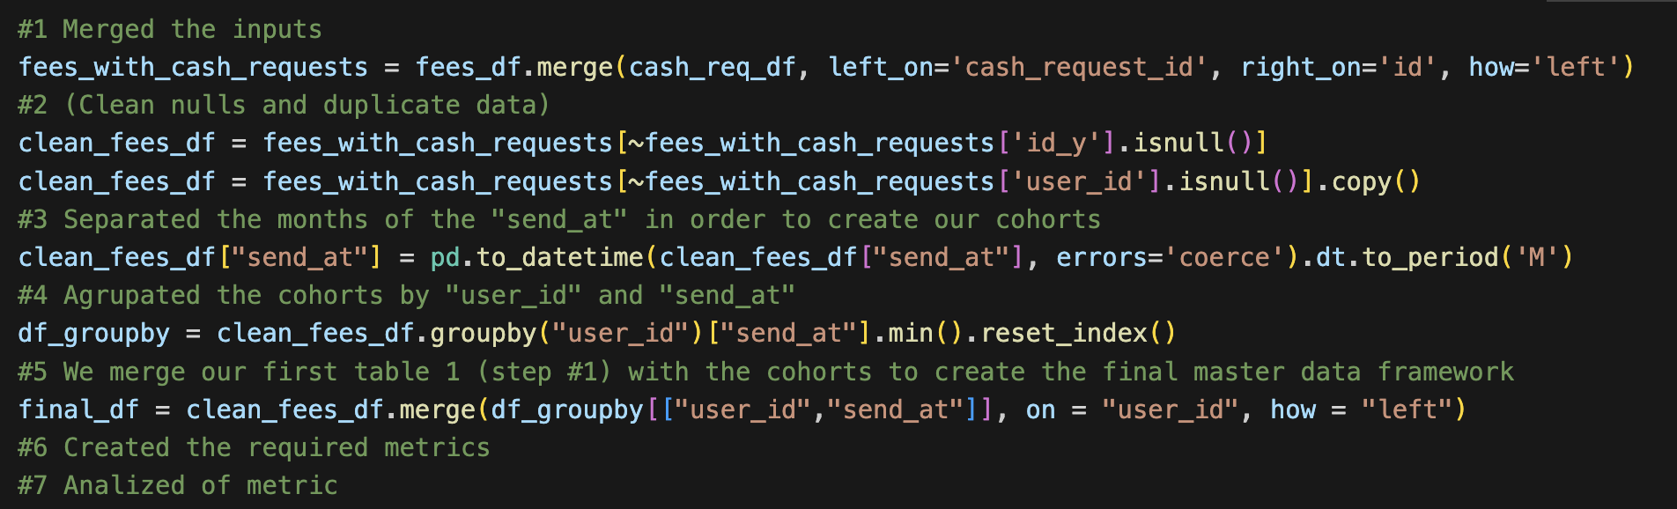
CODE
We created cohorts based on the months in which service users received the money, which occurred over a period of 5 months (from July to October 2020)

Slide 4
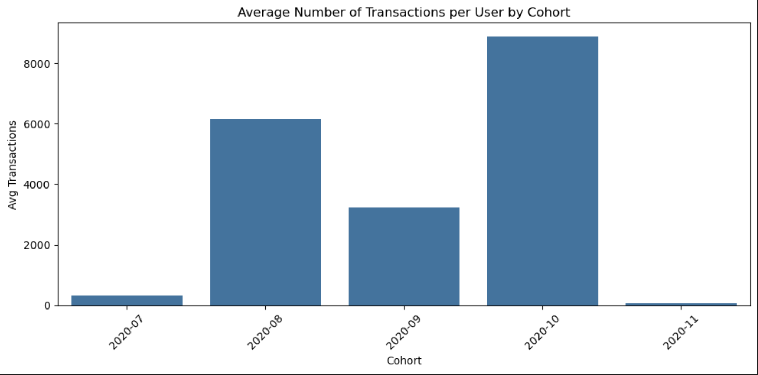
Metrics Analyzed
Frequency =
We summarized (.count) the row of the data processed, throught groupby("cohort")["user_id"]
Insights:
In the “2020-10” cohort we have more transactions than the other ones.
Frequency (how often users interact)

Slide 5
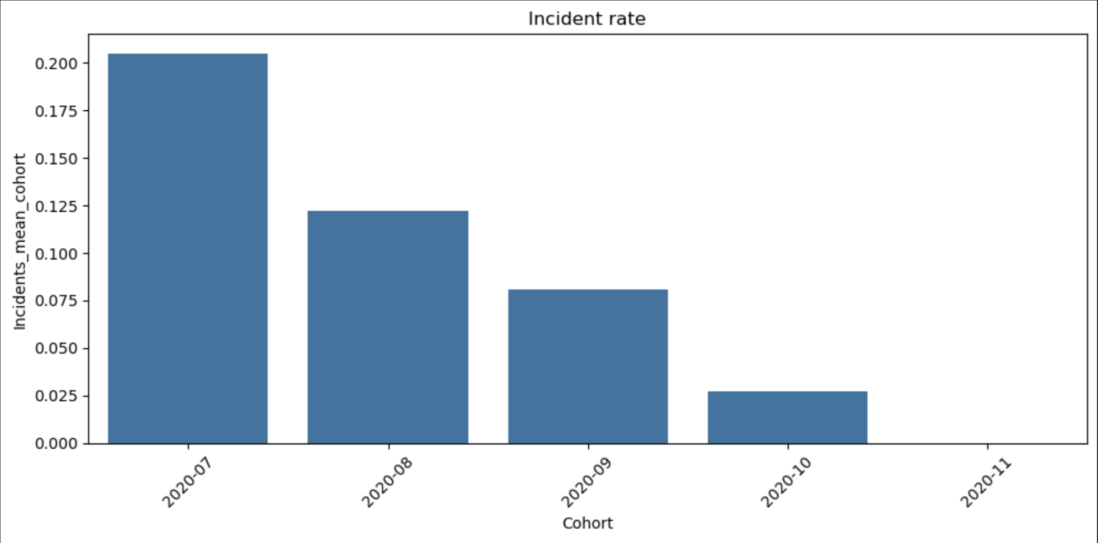
Metrics Analyzed
Incident Rate (issues per user/cohort)
Incident_rate = we changed the value of the incident to 1 and 0 for non-incidents so we don´t have to calculate a percentage. Then we created a new df* named incident rate mean with the cohort and incidents so we get the rate as we can see the incident rate is continuously decreasing

Slide 6

Metrics Analyzed
Revenue (monetary value per user/cohort)
We see that frequency and revenue in October are directly related, which makes sense, as the more the service was used, the more fees were generated.

Slide 7
Coding by:
Jithin kumar
Kaan Tirpanci
Zahory Vasquez

